Slide 1



THE IMPORTANCE OF PROFFESIONAL VIDEO DOCUMENTARIES IN ATTRACTING OR RETAINING DONOR FUNDING
KCBI
KAPOTIVE
CAPACITY
BUILDING
INITIATIVE
THE IMPORATANCE OF PROFESSIONAL VIDEO DOCUMENTARIES IN ATTRACTING OR RETAINING DONOR FUNDING
Programe
THE IMPORTANCE OF PROFFESIONAL VIDEO DOCUMENTARIES IN ATTRACTING OR RETAINING DONOR FUNDING
PRESENTATION
INTRODUCTION

Slide 2

PRESENTATION
//SLIDE
INTRODUCTION
YOUR LOGO
WPS TEMPLATE
Professional video documentaries play a crucial role in the world of nonprofit organizations by effectively communicating their impactful stories, projects, and initiatives to potential donors.
These documentaries are powerful tools that capture and showcase the work being done by these organizations, ultimately aiding in attracting and retaining donor funding.

Slide 3
OBJECTIVES
YOUR LOGO
PRESENTATION
//SLIDE
WPS TEMPLATE
The primary objective of using professional video documentaries in donor funding is to create compelling visual narratives that engage and resonate with the audience, leading to increased support and donations for the cause.

Slide 4

01. Justification
PRESENTATION
//SLIDE
Professional video documentaries are effective in conveying the mission, impact, and significance of nonprofit organizations' work in a visually appealing and emotionally compelling manner. They help in building:
Trust
Credibility
Transparency, which are essential for attracting and retaining donor funding.
THE IMPORTANCE OF PROFFESIONAL VIDEO DOCUMENTARIES IN ATTRACTING OR RETAINING DONOR FUNDING
Presentations are communication tools

Slide 5

02. Reasons Why Video Documentaries:
PRESENTATION
//SLIDE
Reasons Why Video Documentaries are Important in Donor Funding:
- Visual storytelling creates a deeper emotional connection.
- Showcases real impact and success stories.
- Increases visibility and awareness of the organization's cause.
- Engages donors on a more personal level.
- Differentiates the organization from others.
THE IMPORTANCE OF PROFFESIONAL VIDEO DOCUMENTARIES IN ATTRACTING OR RETAINING DONOR FUNDING
Presentations are communication tools

Slide 6
Conti.....
PRESENTATION
//SLIDE
Establishes credibility and trust.
- Demonstrates transparency in operations.
- Can be easily shared and reach a wider audience.
- Conveys complex information in an easily digestible format.
- Inspires action and drives donations.
THE IMPORTANCE OF PROFFESIONAL VIDEO DOCUMENTARIES IN ATTRACTING OR RETAINING DONOR FUNDING
Presentations are communication tools

Slide 7
03. Steps in Making a Compelling Video.
PRESENTATION
//SLIDE
Research and Planning
Storyboarding and Scriptwriting.
Filming and Interviews
Editing and Post-Production.
Adding Music and Voice Overs.
Finalizing and Reviewing.
THE IMPORTANCE OF PROFFESIONAL VIDEO DOCUMENTARIES IN ATTRACTING OR RETAINING DONOR FUNDING
Presentations are communication tools

Slide 8
04. Areas of Focus to Produce a Good Documentary:
Good script
Sound
Video equipment
Voice Over
Good editors
THE IMPORTANCE OF PROFFESIONAL VIDEO DOCUMENTARIES IN ATTRACTING OR RETAINING DONOR FUNDING

Slide 9
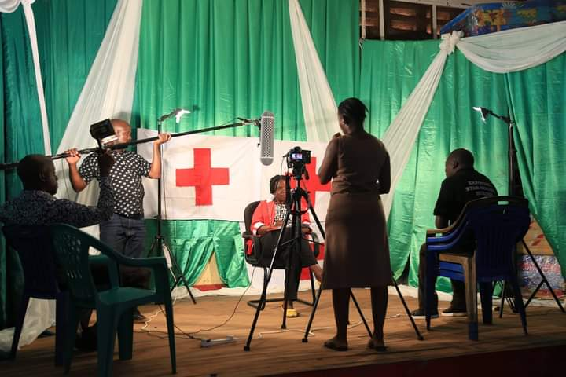
05. Where Videos Can be Embedded
PRESENTATION
//SLIDE
Effective Areas Video Documentaries Can be Embedded for Effectiveness:
Social Media Platforms
Organization's Website
Fundraising Events
Email Campaigns
Presentations
Donor Meetings
THE IMPORTANCE OF PROFFESIONAL VIDEO DOCUMENTARIES IN ATTRACTING OR RETAINING DONOR FUNDING
Presentations are communication tools

Slide 10
05. Where Videos Can be Embedded
PRESENTATION
//SLIDE
Effective Areas Video Documentaries Can be Embedded for Effectiveness:
Social Media Platforms
Organization's Website
Fundraising Events
Email Campaigns
Presentations
Donor Meetings
THE IMPORTANCE OF PROFFESIONAL VIDEO DOCUMENTARIES IN ATTRACTING OR RETAINING DONOR FUNDING
Presentations are communication tools

Slide 11
06. Cost Items in Video Documentaries
PRESENTATION
//SLIDE
Costs may vary depending on the scale and quality of the production:
Filming equipment
Editing software
Location costs
Crew and talent fees
Post-production services
Presentations are communication tools
THE IMPORTANCE OF PROFFESIONAL VIDEO DOCUMENTARIES IN ATTRACTING OR RETAINING DONOR FUNDING

Slide 12
07. Appeal to Use KAPOTIVE Video Production in Producing Quality
Videos
PRESENTATION
//SLIDE
KAPOTIVE Video Production is dedicated to creating high-quality video documentaries that captivate audiences and convey the essence of nonprofit organizations' missions. With a team of experienced professionals, cutting-edge equipment, and a passion for storytelling, KAPOTIVE ensures that your organization's message is delivered effectively and impactfully.
Presentations are communication tools
THE IMPORTANCE OF PROFFESIONAL VIDEO DOCUMENTARIES IN ATTRACTING OR RETAINING DONOR FUNDING

Slide 13
08. Where should we use our Video Documentaries
Fundraising events: Video documentaries can be used to showcase the impact of donations and inspire supporters to contribute towards a cause.
Grant applications: Including a video documentary as part of a grant application can help funders better understand the work being done and the impact it has.
Social media campaigns: Short video documentaries can be shared on social media platforms to raise awareness and engage a wider audience in supporting a cause.
THE IMPORTANCE OF PROFFESIONAL VIDEO DOCUMENTARIES IN ATTRACTING OR RETAINING DONOR FUNDING

Slide 14
Conti...
Donor meetings: Video documentaries can be a powerful tool to communicate the mission, values, and impact of an organization to potential donors during meetings or presentations.
Overall, video documentaries are a versatile and engaging medium that can be used to effectively communicate a nonprofit's message and impact, thus helping to mobilize resources and support.
THE IMPORTANCE OF PROFFESIONAL VIDEO DOCUMENTARIES IN ATTRACTING OR RETAINING DONOR FUNDING

Slide 15
09. Conclusion
PRESENTATION
//SLIDE
In conclusion, professional video documentaries are essential tools in the nonprofit sector for attracting and retaining donor funding. By investing in high-quality video productions, organizations can amplify their impact, reach broader audiences, and inspire lasting support for their causes.
KAPOTIVE Capacity Building Initiatives is inviting you to a scheduled Zoom meeting.
Presentations are communication tools
THE IMPORTANCE OF PROFFESIONAL VIDEO DOCUMENTARIES IN ATTRACTING OR RETAINING DONOR FUNDING

Slide 16
www.kapotive.or.tz
Tel: +255 767 047 621
Tel: +255 711 326 789
Whatsapp Link
https://chat.whatsapp.com/LqosgEAG6no4qY2RaRPqe2

